Slide 1
Data logging with mqtt
Data Logging Zero to Hero with CircuitPython and MQTT

Slide 2
Abstract
To familiarize with the world of hardware and build a full-stack Io T(Internet-of-Things) solution.
To publish data from a sensor over MQTT, persist the data and visualize it in real time.
To demonstrate a beginner friendly workflow that is not too complicated using Circuit Python.
To demonstrates a solution that has real world applications - logging sensor data over a network, storing it in a database and displaying the data on a dashboard.

Slide 3
Aim & Objectives
The system allows to remotely monitor and water plants over the internet. The system monitor the moisture of your favourite houseplant and be able to water it from anywhere you can get an internet connection.
This project aims is to measure the various parameters like moisture values, and can water the plant accordingly by sending a request to the web server. The data can be stored online, the moisture value is sent from the NodeMCU to the web server, and the watering command is sent from the web server to the NodeMCU.

Slide 4
Hardware components
Software components
Maximum Integrated DS18B20 Programmable Resolution 1-Wire Digital Thermometer
Adafruit Metro M4 Express AirLift(WiFi)
Basic knowledge of Python
A text editor or IDE
Open source software that doesn't require internet connection, maintaining privacy and keeping life simple

Slide 5
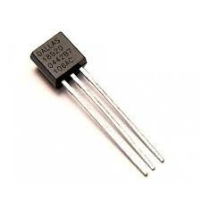
Hardware
DS18B20 is a digital temperature sensor which follows 1-wire protocol and can measure temperature.
Data received from the single wire is in the ranges of 9-bit to 12-bit.

Slide 6
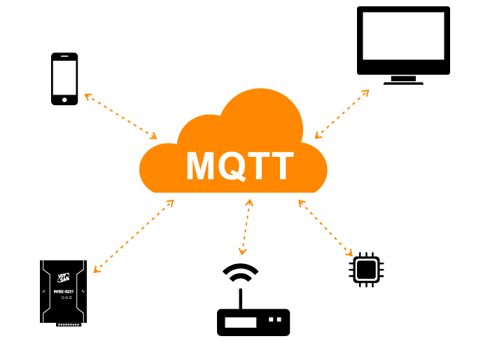

Slide 7
MQTT Discussion
MQTT is one of the most commonly used protocols in Io T projects. It stands for Message Queuing Telemetry Transport.
It is designed as a lightweight messaging protocol that uses publish/subscribe operations to exchange data between clients and the server.
Furthermore, its small size, low power usage, minimized data packets and ease of implementation make the protocol ideal of the “machine-to-machine” or “Internet of Things” world.

Slide 8
Why MQTT?
MQTT has unique features you can hardly find in other protocols, like:
It’s a lightweight protocol. So, it’s easy to implement in software and fast in data transmission.
It’s based on a messaging technique. Of course, you know how fast your messenger/WhatsApp message delivery is. Likewise, the MQTT protocol.
Minimized data packets. Hence, low network usage.
Low power usage. As a result, it saves the connected device’s battery.
It’s real time! That’s is specifically what makes it perfect for IoT applications.

Slide 9
How MQTT works?
Like any other internet protocol, MQTT is based on clients and a server. Likewise, the server is the guy who is responsible for handling the client’s requests of receiving or sending data between each other.
MQTT server is called a broker and the clients are simply the connected devices.
When a device (a client) wants to send data to the broker, we call this operation a “publish”.
When a device (a client) wants to receive data from the broker, we call this operation a “subscribe”.

Slide 10
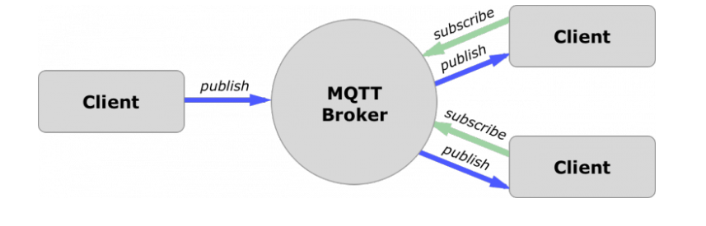
How MQTT works?
These clients are publishing and subscribing to topics. So, the broker here is the one that handles the publishing/subscribing actions to the target topics.

Slide 11
MQTT Components
Broker, which is the server that handles the data transmission between the clients.
A topic, which is the place a device want to put or retrieve a message to/from.
The message, which is the data that a device receives “when subscribing” from a topic or send “when publishing” to a topic.
Publish, is the process a device does to send its message to the broker.
Subscribe, where a device does to retrieve a message from the broker.

Slide 12
Why Not HTTP?
HTTP is slower, more overhead and power consuming protocol than MQTT. So, let’s get into each one separately:
Slower: because it uses bigger data packets to communicate with the server.
Overhead: HTTP request opens and closes the connection at each request, while MQTT stays online to make the channel always open between the broker “server” and clients.
Power consuming: since it takes a longer time and more data packets, therefore it uses much power.

Slide 13
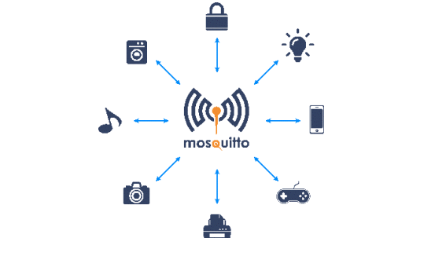
Which broker to use?
Mosquitto Broker
Mosquitto is an open source message broker that implements the MQTT protocol. It’s lightweight and suitable for use on all devices from a low power single board like Arduino, ESP8266 to full computers and servers.

Slide 14
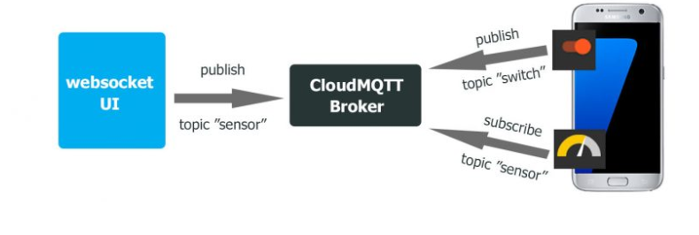
CloudMQTT broker
CloudMQTT is one of the best and easiest cloud-based Mosquitto broker.
CloudMQTT has a free plan that allows you to set up your own CloudMQTT broker instance that will run on their hardware servers. Hence, you can have an online broker that’s ready to use in your IoT project.
It also has a well designed GUI to monitor the publishing and subscribing processes and topics through an easy to use WebSocket UI.

Slide 15
Thank you for watching

